Slide 1

Lecture 09 – Attention and Transformers
Baojian Zhou
DATA130030.01 (自然语言处理)
School of Data Science Fudan University
05/10/2023
Notes:
Attention and Transformers

Slide 2
Outline
Encoder-Decoder Model

Slide 3
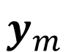
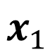
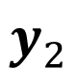
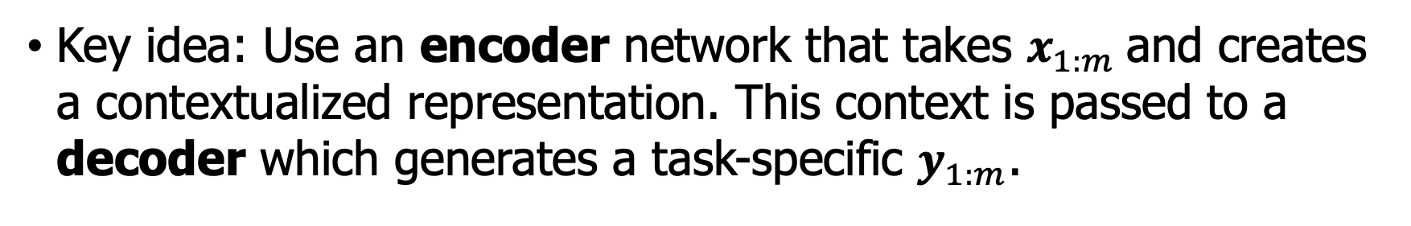
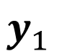
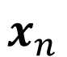
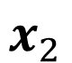
Encoder-Decoder Model
Key idea: Use an encoder network that takes $x_{1:m}$and creates a contextualized representation. This context is passed to a decoder which generates a task-specific $y_{1:m}$.
$$y_{1}$$
$$y_{2}$$
…
$$y_{m}$$
Encoder
Context is a function of the hidden representations of the input, is used by the decoder.
Context
Encoder
$$x_{1}$$
$$x_{2}$$
…
$$x_{n}$$

Slide 4
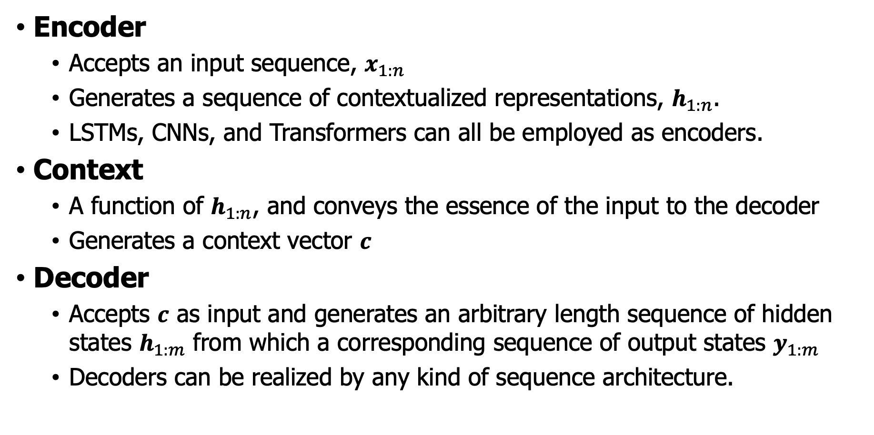
Three components of encoder-decoder nets
Encoder
Accepts an input sequence, $x_{1:n}$
Generates a sequence of contextualized representations, $h_{1:n}$.
LSTMs, CNNs, and Transformers can all be employed as encoders.
Context
A function of $h_{1:n}$, and conveys the essence of the input to the decoder
Generates a context vector $c$
Decoder
Accepts $c$ as input and generates an arbitrary length sequence of hidden states $h_{1:m}$ from which a corresponding sequence of output states $y_{1:m}$
Decoders can be realized by any kind of sequence architecture.

Slide 5
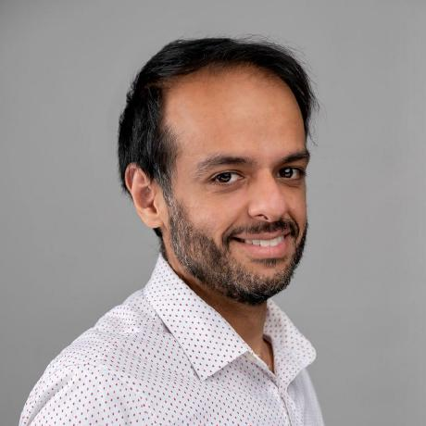
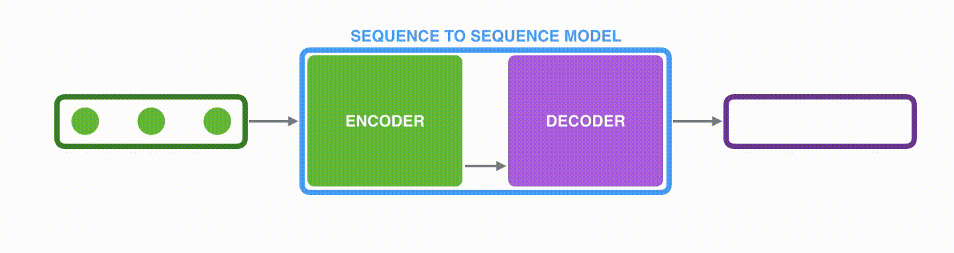
Visualization of Encoder-Decoder Model
The encoder processes each item in the input sequence, it compiles the information and captures into a context vector.
The encoder sends the context over to the decoder, which begins producing the outputs item by item.
Credits to Jay Alammar
https://jalammar.github.io/visualizing-neural-machine-translation-mechanics-of-seq2seq-models-with-attention/

Slide 6
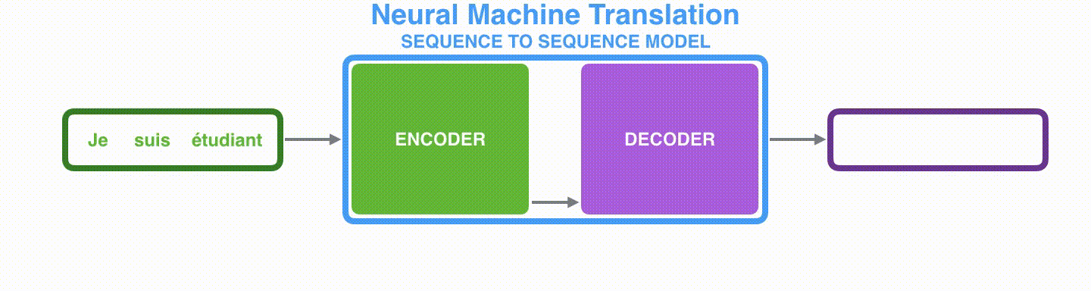
Encoder-Decoder Model
Machine translation task:
je suis étudiant -> i am a student
The encoder and decoder tend to both be recurrent neural networks (e.g., LSTM). The context would be of a size like 256, 512, or 1024.

Slide 7
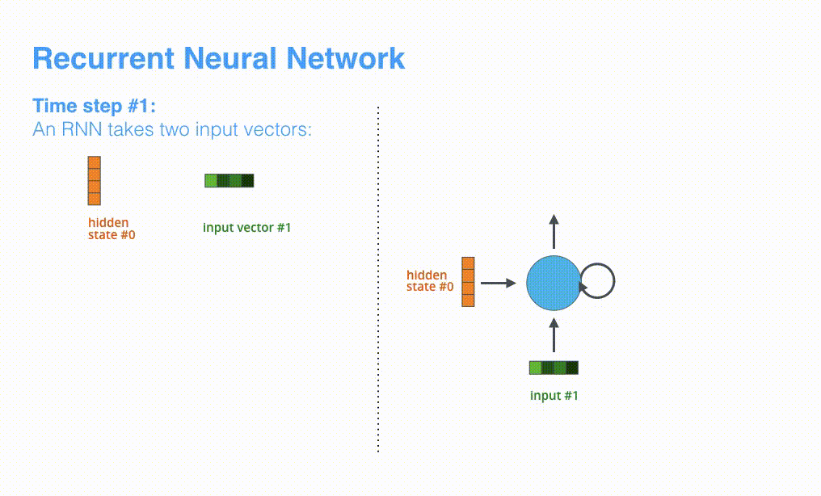
RNN-based encoder-decoder nets
je suis étudiant -> i am a student

Slide 8
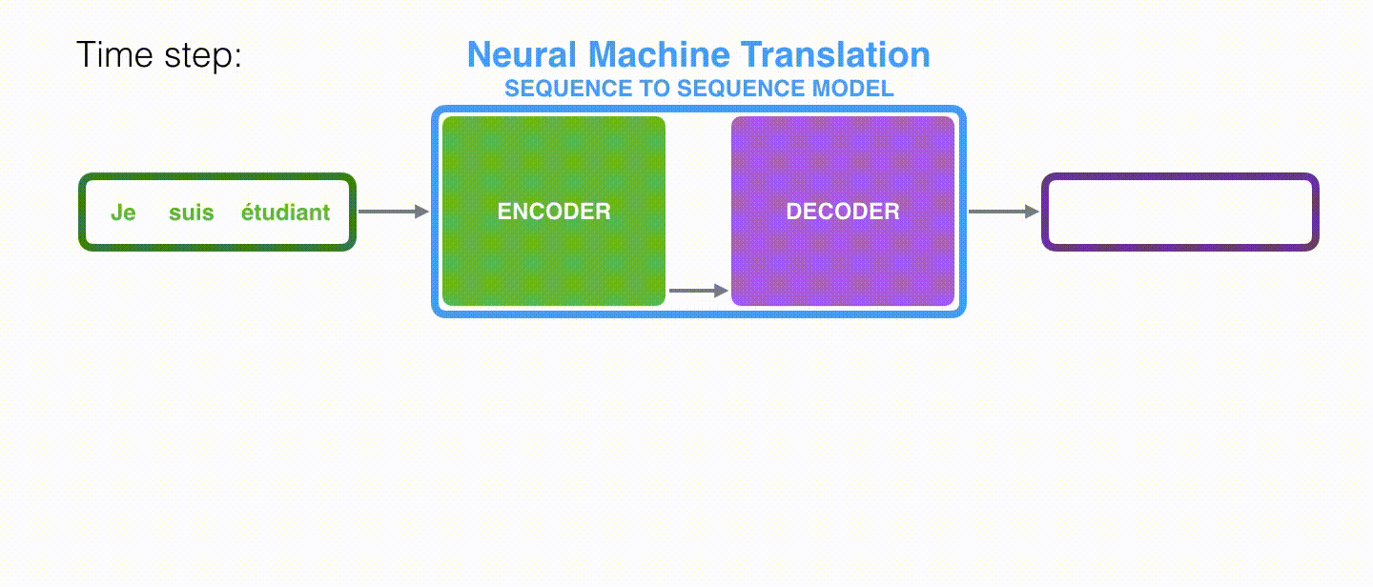
RNN-based encoder-decoder nets
Context and outputs are generated step by step!

Slide 9
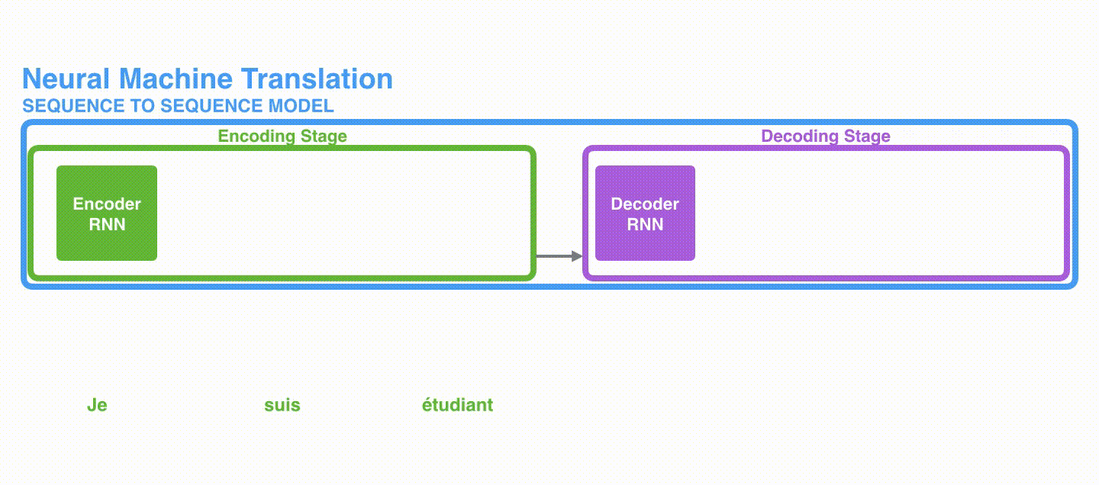
RNN-based encoder-decoder nets

Slide 10
Outline
Encoder-Decoder Model
Attention and Self-Attention

Slide 11
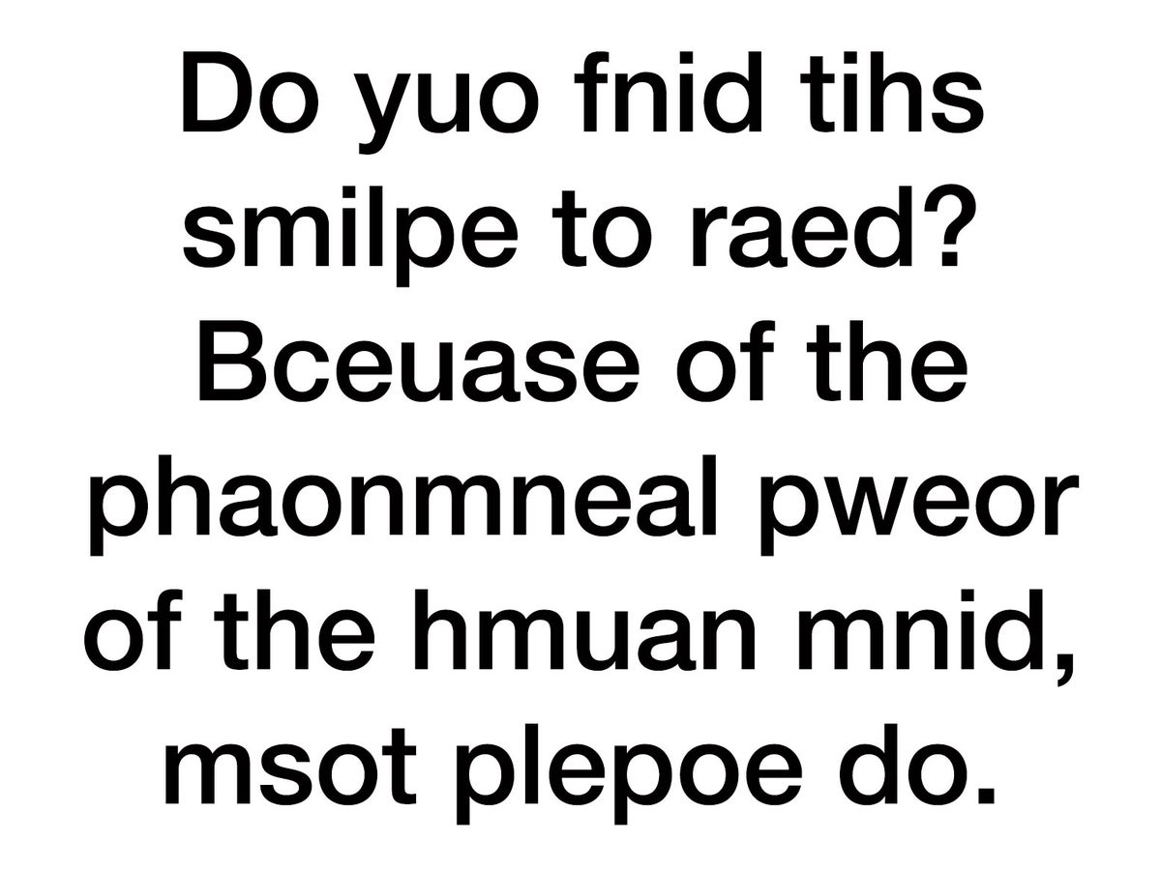
Attention in human behavior
Notes:
我们的注意力在文字不是在错误上。

Slide 12
Attention in human behavior
At a very large and very noisy party, you’re looking for a friend you’ve lost in the crowd.
You look for her green dress amid the sea of colors.
You try to catch the sound of her voice in the general roar.
There she is!
Somehow, above the loud music and noisy conversation, now you hear her calling your name.
But before you can move very far, you are stopped in your tracks by the sound of shattering glass—you turn your head sharply and see that a pitcher has fallen off a nearby table.
While others tend to the glass, you set off across the crowded room toward your friend.
Notes:
在一个非常大且嘈杂的聚会上，你正在寻找在人群中失散的朋友。
你在五彩缤纷的人群中寻找她的绿色连衣裙。
你试图从整个喧闹声中捕捉她的声音。
找到她了！
不知何故，在响亮的音乐和喧闹的对话声中，你现在听到她在喊你的名字。
但在你还没有走多远之前，被摔碎的玻璃声惊呆了——你猛地转过头，发现一个水壶从附近的桌子上掉了下来。
当其他人处理破碎的玻璃时，你穿过拥挤的房间向你的朋友走去。

Slide 13
Attention in human behavior
The processes by which you were able to spot your friend, hear your name despite the noise of the party, and then quickly turn toward and then away from the sound of the breaking glass involved attention.
In the context of human information processing, attention is the process that, at a given moment, enhances some information and inhibits other information. The enhancement enables us to select some information for further processing, and the inhibition enables us to set some information aside.
Notes:
在聚会的嘈杂声中，你能够发现你的朋友、听到自己的名字，然后迅速转向并远离摔碎的玻璃声，这些过程都涉及到了注意力。
在人类信息处理的背景下，注意力是一种在特定时刻增强某些信息并抑制其他信息的过程。
这种增强作用使我们能够选择一些信息进行进一步处理，而抑制作用使我们能够将一些信息置之不理。

Slide 14
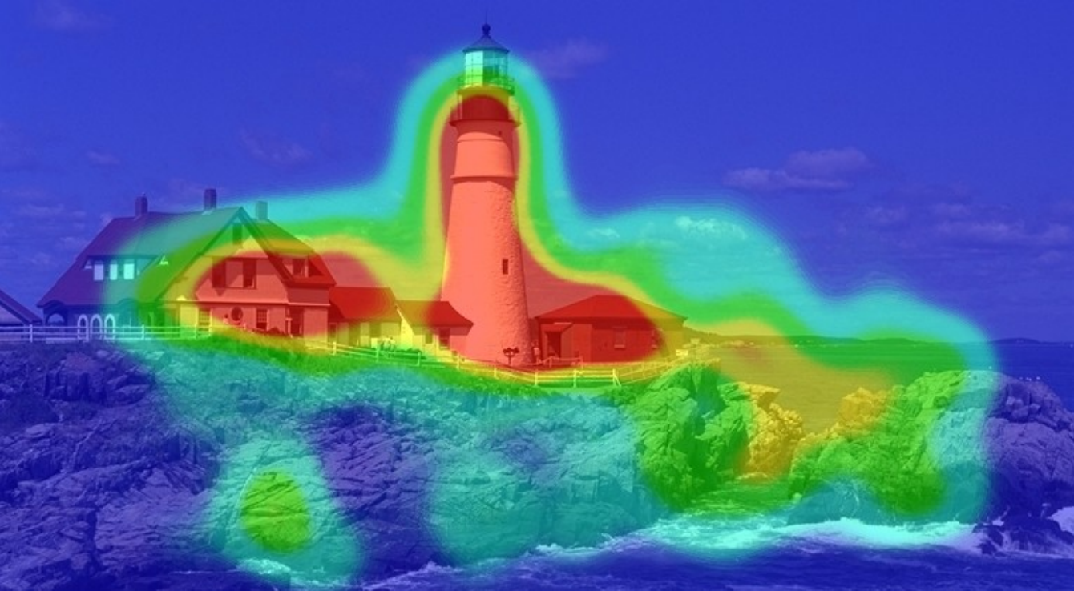
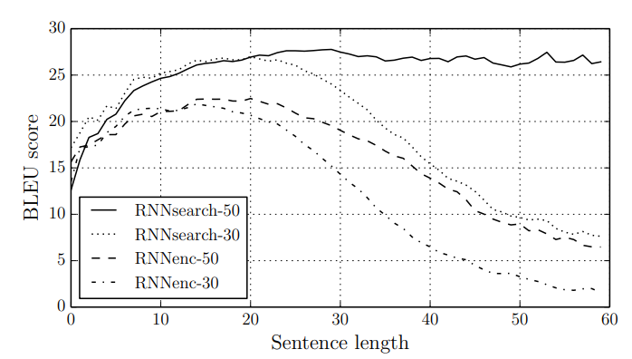
Attention in CV and NLP
Attention in Computer Vision
2014, Attention used to highlight important parts of an image that contribute to a desired output.
Attention in NLP
2015, Aligned machine translation
Notes:
在机器学习的背景下，注意力是一种模仿认知注意力的技术，定义为选择和专注于相关刺激的能力。 换句话说，注意力是一种试图增强重要部分同时淡化不相关信息的方法。
大家做过英语的阅读理解，

Slide 15
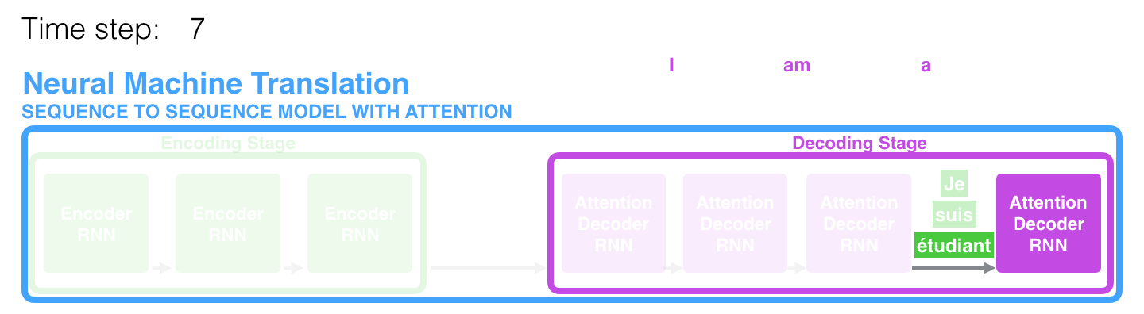
RNNs with Attention
A solution was proposed in Bahdanau et al., 2014 and Luong et al., 2015. They introduced “Attention”. Attention allows the model to focus on the relevant parts of the input sequence as needed.
At time step 7, the attention enables the decoder to focus on the word "étudiant" before it generates the translation. This ability to amplify the signal from the relevant part of the input sequence makes attention models produce better results than models without attention.

Slide 16
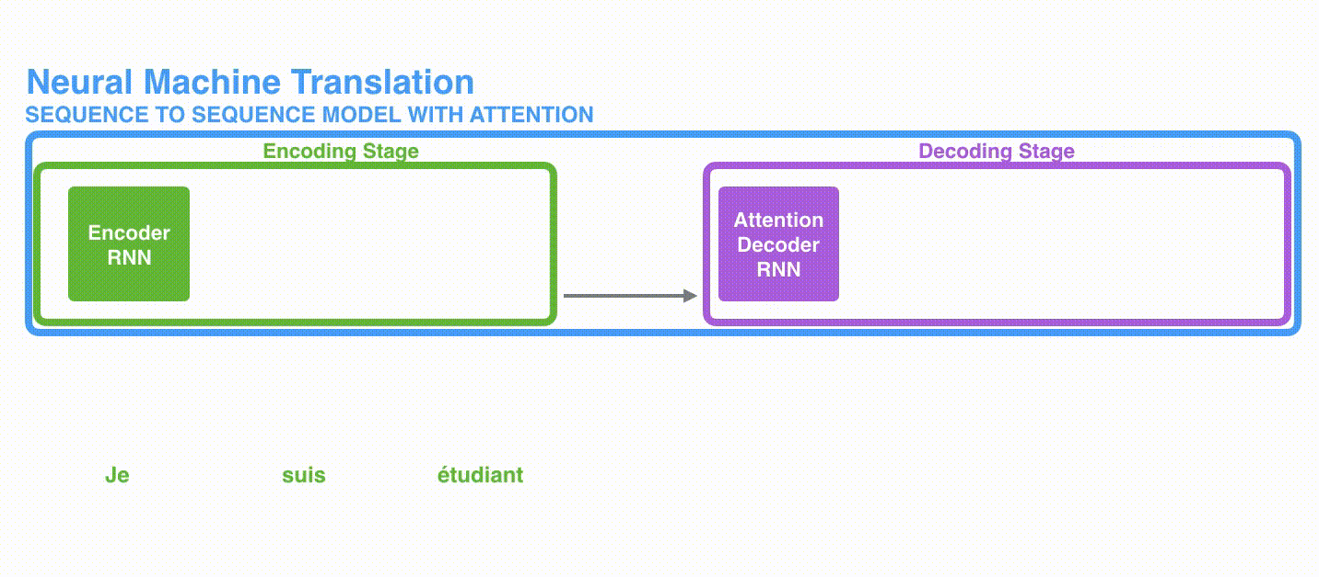
RNNs with Attention
Attention has been used in decoder part

Slide 17
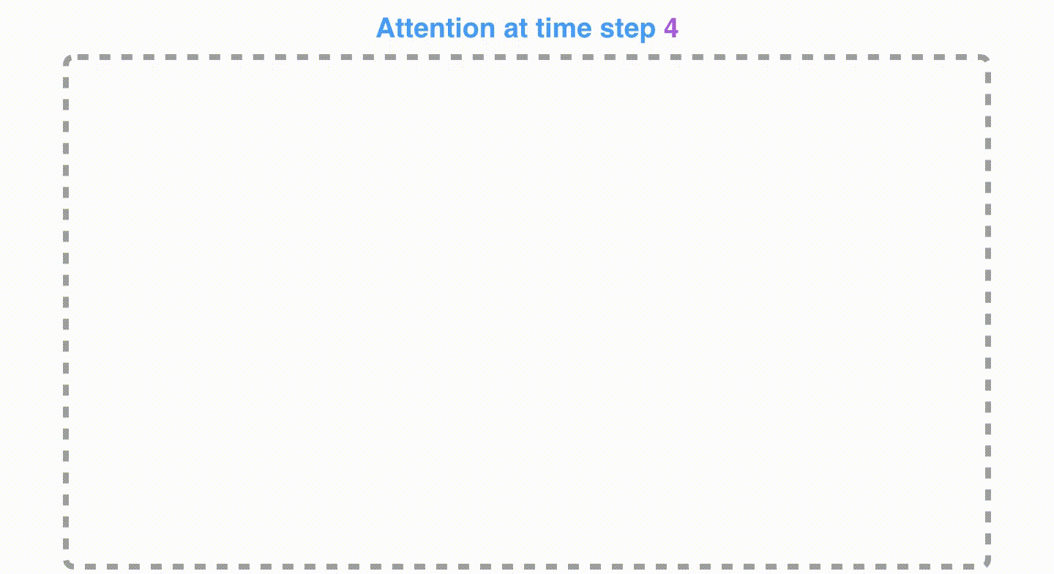
RNNs with Attention
Attention process

Slide 18
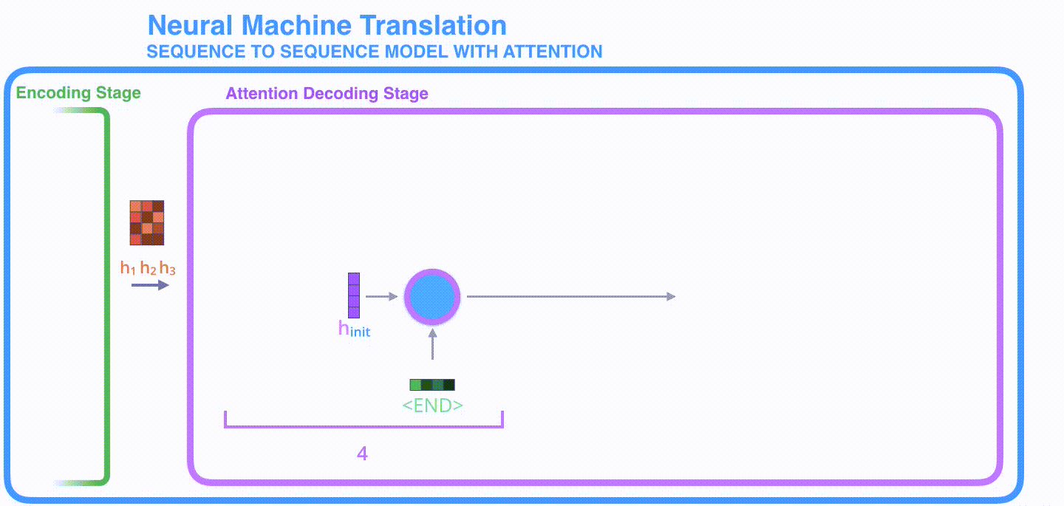
RNNs with Attention
Concatenated decoding vectors have more and better contexts of input sentence.
Notes:
The attention decoder RNN takes in the embedding of the <END> token, and an initial decoder hidden state.
The RNN processes its inputs, producing an output and a new hidden state vector (h4). The output is discarded.
Attention Step: We use the encoder hidden states and the h4 vector to calculate a context vector (C4) for this time step.
We concatenate h4 and C4 into one vector.
We pass this vector through a feedforward neural network (one trained jointly with the model).
The output of the feedforward neural networks indicates the output word of this time step.
Repeat for the next time steps

Slide 19
Transformer
The rest slides will introduce
Self-Attention and Transformer

Slide 20
Outline
Encoder-Decoder Model
Attention and Self-Attention
Attention mechanisms intuition

Slide 21

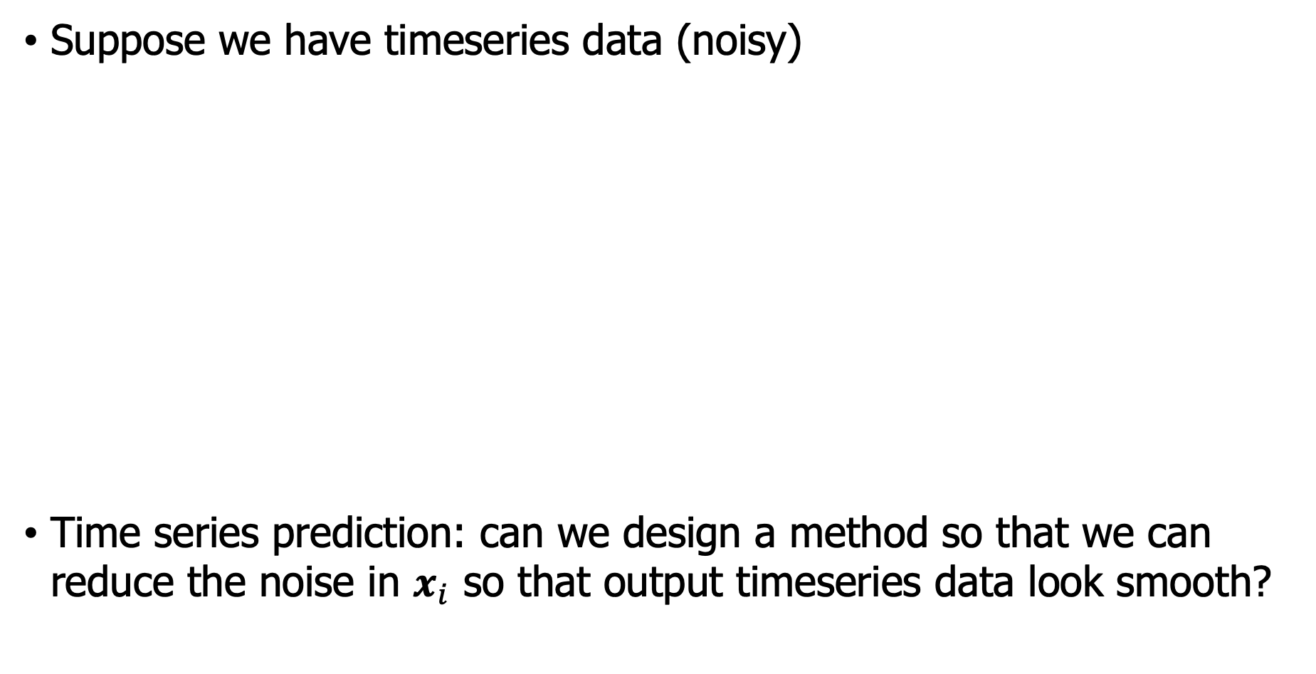
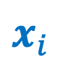
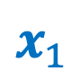
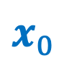
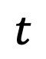
Attention mechanisms Intuition
Suppose we have timeseries data (noisy)
Time series prediction: can we design a method so that we can reduce the noise in $x_{i}$ so that output timeseries data look smooth?
$x_{i}$
$x_{n}$
…
…
$x_{1}$
$x_{0}$
$$t$$
Notes:
对于一个时间序列任务， 我们想一下如何使用注意力机制来做这件事件。我们希望能够从中得到一点关于注意机制的直觉。
在这里，我们有一个时间序列，这些数据点是按照时间轴一个一个的出现、生成。
最右边的这个我们叫X_0，我会称它为 X_0 然后在这里我有, 其他一些数据点，我将称之为 X_i.

Slide 22
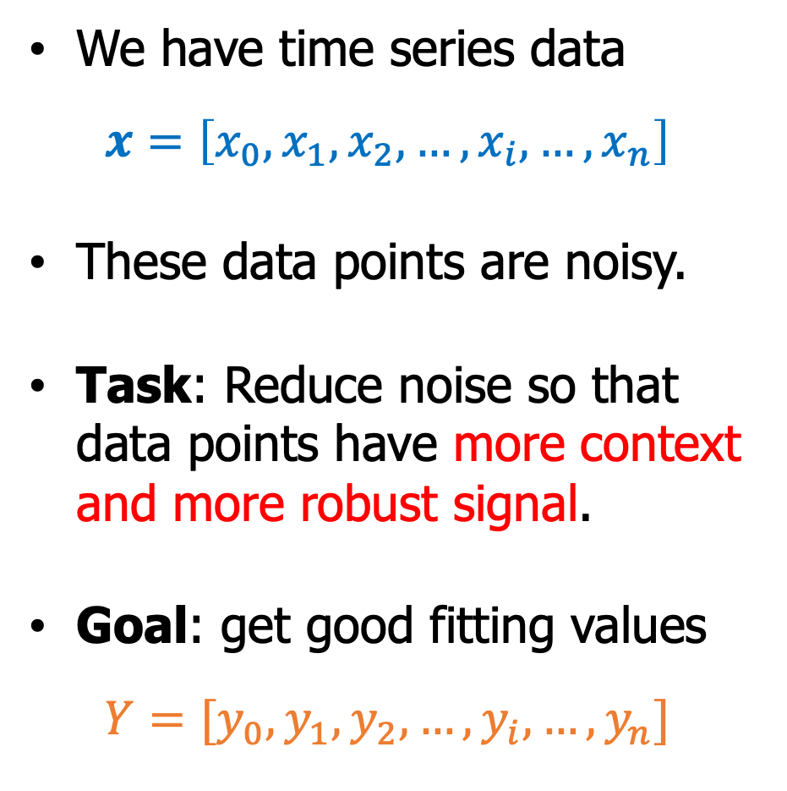
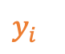
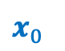

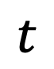
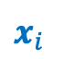
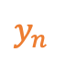
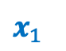
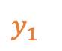
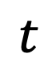
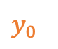
Attention mechanisms Intuition
Time series prediction Task
We have time series data
$$x=\left[x_{0},x_{1},x_{2},…,x_{i},…,x_{n}\right]$$
These data points are noisy.
Task: Reduce noise so that data points have more context and more robust signal.
Goal: get good fitting values
$$Y=[y_{0},y_{1},y_{2},…,y_{i},…,y_{n}]$$
$x_{i}$
$x_{n}$
…
…
$x_{1}$
$x_{0}$
$$t$$
…
…
$y_{n}$
$y_{i}$
$y_{0}$
$y_{1}$
$$t$$
Notes:
当然，这是正确连接的，所以这是一个时间序列，我们称之为时间序列数据。 我们把那个 X 称为正确的，所以这是一个数组，所以我们一直得到 X_0 直到 X_n。
现在，让我们考虑一下如何使这个时间序列更具相关性。 这个时间序列有一个缺点，时间序列有噪音，所以也许我们可以想出一个减少噪音的操作，通过减少噪音，有更多的上下文，剩下的有更多的信号，并且有很多方法可以做到这一点。
那，我们是不是可能找到一种操作方法，降低噪音同时又能保持上下文关系，这里的上下文关系就是，离得近的点，它们的值比较相近。

Slide 23

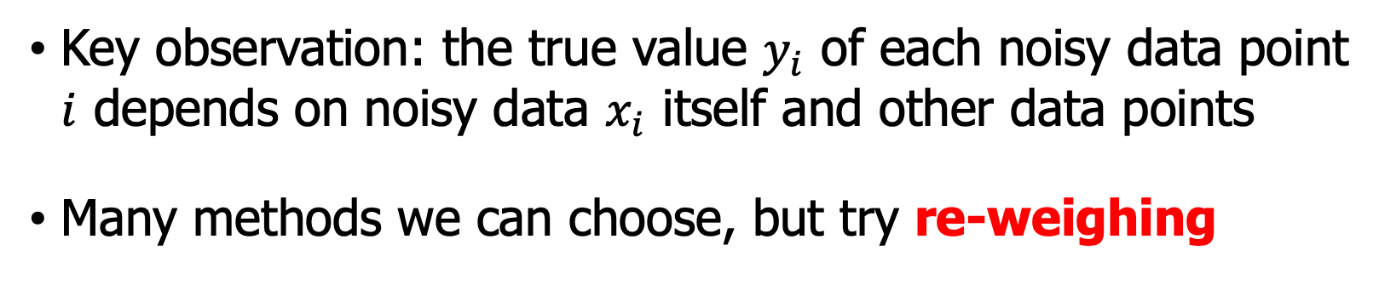
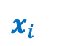
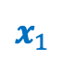
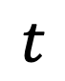
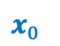
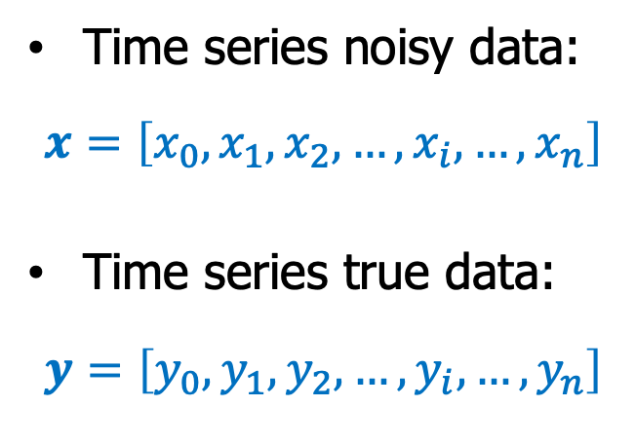
Attention mechanisms Intuition
Time series prediction Task
$x_{i}$
Time series noisy data:
$$x=\left[x_{0},x_{1},x_{2},…,x_{i},…,x_{n}\right]$$
Time series true data:
$$y=\left[y_{0},y_{1},y_{2},…,y_{i},…,y_{n}\right]$$
$x_{n}$
…
…
$x_{1}$
$x_{0}$
$$t$$
Key observation: the true value $y_{i}$ of each noisy data point $i$ depends on noisy data $x_{i}$ itself and other data points
Many methods we can choose, but try re-weighing
Notes:
我们通过一种叫，重新定义权值re-weighing，我们对于每个数据点x_i，这个是怎么操作的呢？

Slide 24
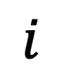
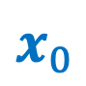


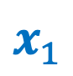
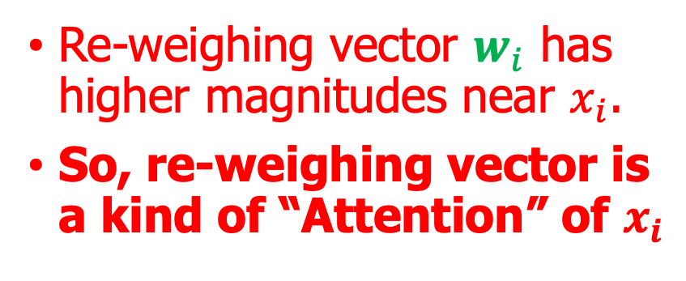
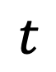
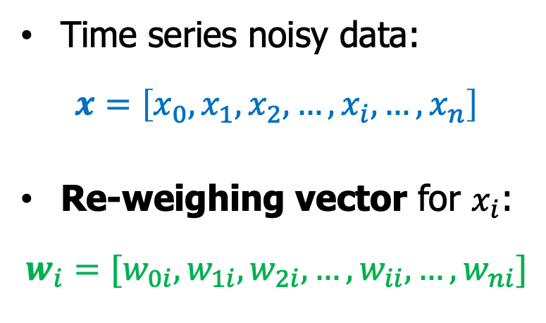
Attention mechanisms Intuition
Time series prediction Task
$x_{i}$
Time series noisy data:
$$x=\left[x_{0},x_{1},x_{2},…,x_{i},…,x_{n}\right]$$
Re-weighing vector for $x_{i}$:
$$w_{i}=[w_{0i},w_{1i},w_{2i},…,w_{ii},…,w_{ni}]$$
$x_{n}$
…
…
$x_{1}$
$x_{0}$
$$t$$
Re-weighing vector $w_{i}$ has higher magnitudes near $x_{i}$.
So, re-weighing vector is a kind of “Attention” of $x_{i}$
$$i$$
Notes:
我们通过一种叫，重新定义权值，我们对于每个数据点x_i，这个是怎么操作的呢？
每一个点都对当前点x_i有个影响，我们不知道这个影响有多少？获取context
每一个点假设都map到这条曲线上去。

Slide 25
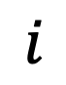



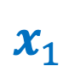


Attention mechanisms Intuition
Time series prediction Task
$x_{i}$
$x_{n}$
Idea of re-weighing
…
…
$x_{1}$
Time series data:
$$x=\left[x_{0},x_{1},x_{2},…,x_{i},…,x_{n}\right]$$
Re-weighing:
$$w_{i}=[w_{0i},w_{1i},w_{2i},…,w_{ii},…,w_{ni}]$$
Each $w_{ji}$: weight of data point $x_{j}$
$x_{0}$
$$t$$
$$w_{ii}$$
$$i$$
Notes:
对于每一个点，对x_i的影响，我们都在这个曲线函数上取点
所以，我们每一个点x_j都有一个w_ji来衡量对x_i的影响力

Slide 26




Attention mechanisms Intuition
Time series prediction Task
$x_{i}$
$x_{n}$
Idea of re-weighing
…
…
Time series data:
$$x=\left[x_{0},x_{1},x_{2},…,x_{i},…,x_{n}\right]$$
Re-weighing vector
$$w_{i}=[w_{0i},w_{1i},w_{2i},…,w_{ii},…,w_{ni}]$$
Each $w_{ji}$: Weight of data point $x_{j}$
Fitting value
$$y_{i}=w_{i}⋅x$$
$x_{1}$
$x_{0}$
$$t$$
$$w_{ii}$$
$y_{i}$
Notes:
如何通过什么方式来得到一个过滤后的信号y_i，我们通过dot product，点积
特性，离x_i近的那些点权重值比较高，离x_i点远的权重值比较低

Slide 27










Attention mechanisms Intuition
Time series prediction Task
$x_{i}$
$x_{n}$
…
Idea of re-weighing
…
Time series data:
$$x=\left[x_{0},x_{1},x_{2},…,x_{i},…,x_{n}\right]$$
Re-weighing vector
$$w_{i}=[w_{0i},w_{1i},w_{2i},…,w_{ii},…,w_{ni}]$$
Each $w_{ji}$: The weight of data point $x_{j}$
Fitting value
$y_{i}=w_{i}⋅x, i$ from $0 1 2$ to $n$
$x_{1}$
$x_{0}$
$$t$$
$$w_{ii}$$
$y_{n}$
$y_{i}$
$y_{0}$
$y_{1}$
Notes:
这样的话，我们可以通过re-weighing操作，来对每一个y_i都进行这样的样的操作
这个时候w_i就有n+1一个向量。

Slide 28

Attention mechanisms Intuition
Time series prediction Task
$x_{i}$
Idea of re-weighing
$x_{n}$
Time series data:
$$x=\left[x_{0},x_{1},x_{2},…,x_{i},…,x_{n}\right]$$
Re-weighing vector
$$w_{i}=[w_{0i},w_{1i},w_{2i},…,w_{ii},…,w_{ni}]$$
Each $w_{ji}$: Weight of data point $x_{j}$
Fitting: $y_{i}=w_{i}⋅x, i=0, 1, …,n$.
Re-weighing is to find such reasonable “context” matrix
$$W=\left[w_{0},w_{1},…,w_{n}\right]$$
so that we can get better signals by using contexts of data points.
…
…
$x_{1}$
$x_{0}$
$$t$$
$$w_{ii}$$
$y_{n}$
$y_{i}$
$y_{0}$
$y_{1}$
Notes:
那么为什么会有这样的效果呢？是因为我们使用w_i，每一个w_i都可以当成一个过滤器，把信号相关的数据点放大，把信号相关性弱的点缩小。所以，这种形状的w_i是非常合理的，这种方式的顾虑器，就是加入了context 上下文。
那么，如果我们找到了一组这样的很好的值，那么我们的任务是不是就完成了。

Slide 29

Attention mechanisms Intuition
Time series prediction Task
$x_{i}$
Idea of re-weighing
$x_{n}$
…
…
Time series data:
$$x=\left[x_{0},x_{1},x_{2},…,x_{i},…,x_{n}\right]$$
Re-weighing:
$$w_{i}=[w_{0i},w_{1i},w_{2i},…,w_{ii},…,w_{ni}]$$
Quick summary of $W$: it filters datapoints which are far away from $x_{i}$ but amplifies datapoints that are close to $x_{i}$.
How can we apply this re-weighing idea to text data ?
$x_{1}$
$x_{0}$
$$t$$
$$w_{ii}$$
$y_{n}$
$y_{i}$
$y_{0}$
$y_{1}$
Notes:
总结一下，这个 re-weighing 方法，它过滤远离𝑥_𝑖的数据点，但放大靠近𝑥_𝑖的数据点。
好，这种re-weighing 思想看起比较有用，我们处理的文本数据。

Slide 30
Get more context for text
Get a more context for: Noa can be annoying but she is a great cat.
Given the above sentence, how can we get more and better context for these words?
Noa can be annoying but she is a great cat.
Notes:
这里的一个任务是给定一个句子，我们想得到一个更好的context，或者关于这个句子更多的context。
句子 “Noa 可能很烦人，但她是一只很棒的猫咪。”
跟我们刚才选取了一个x_i，一样，我们在句子中选一个单词来考察一下这个句子。，假设我们选了annoying

Slide 31
Get more context for text
Get a more context for: Noa can be annoying but she is a great cat.
But the intuition tells that proximity might not be the best thing in language. Relations between words have to do with linguistic meaning and structures.
Words closer to annoying have more effects on the word annoying.
Noa can be annoying but she is a great cat.
Notes:
我们给出这个假设：离得近的单词对annoying影响大。
根据，我们刚才的re-weighing策略，或者RNN的思想，近的单词
NEXT：be but
NEXT：can she
NEXT：Noa is

Slide 32
Get more context for text
Get a more context for: Noa can be annoying but she is a great cat.
Words closer to annoying have more effects on the word annoying.
Words Noa, is and cat are “closer” to she. So, we cannot blindly use proximity.
Noa can be annoying but she is a great cat.
Notes:
但是，如果我们she这个单词跟这个句子表达的意义联系起来就不一样了。
也就是说，我们如果要分析she 这个单词在句子中表达的含义，我们的注意力应该放在哪里？，应该放在哪几个单词上？
NEXT：she可以跟Noa有很好的，联系，我们的注意力应该关注Noa，对吧，因为英语语法要求我们要看到名字才能知道是否用she、he
NEXT：is 也是根据语法规则，这里不可能出现are
NEXT：she指的是 cat
我们为什么要注意这种规则，因为这种规则跟she周围的距离没有关系。
所以，我们不能盲目的去使用proximity，距离关系

Slide 33
Get more context for text
Get a more context for: Noa can be annoying but she is a great cat.
Words Noa, is and cat are “closer” to she. So, we cannot blindly use proximity.
To think of a way to do this automatically.
Noa can be annoying but she is a great cat.
Tokens $t_{1}$ $t_{2}$ $t_{3}$ $t_{4}$ $t_{5}$ $t_{6}$ $t_{7}$ $t_{8}$ $t_{9}$ $t_{10}$
Notes:
那么我们怎么获取这种关系，首先把单词化成tokens
一起是10个单词，

Slide 34
Get more context for text
Get a more context for: Noa can be annoying but she is a great cat.
Words Noa, is and cat are “closer” to she. So, we cannot blindly use proximity.
Think of a way to do this automatically.
Noa can be annoying but she is a great cat.
Tokens $t_{1}$ $t_{2}$ $t_{3}$ $t_{4}$ $t_{5}$ $t_{6}$ $t_{7}$ $t_{8}$ $t_{9}$ $t_{10}$
Embedding $v_{1}$ $v_{2}$ $v_{3}$ $v_{4}$ $v_{5}$ $v_{6}$ $v_{7}$ $v_{8}$ $v_{9}$ $v_{10}$
Notes:
1. 然后每一个单词我们都一个词嵌入来表示这个token

Slide 35
Get more context for text
Get a more context for: Noa can be annoying but she is a great cat.
Words Noa, is and cat are “closer” to she. So, we cannot blindly use proximity.
Think of a way to do this automatically.
Noa can be annoying but she is a great cat.
Tokens $t_{1}$ $t_{2}$ $t_{3}$ $t_{4}$ $t_{5}$ $t_{6}$ $t_{7}$ $t_{8}$ $t_{9}$ $t_{10}$
Embedding $v_{1}$ $v_{2}$ $v_{3}$ $v_{4}$ $v_{5}$ $v_{6}$ $v_{7}$ $v_{8}$ $v_{9}$ $v_{10}$
Re-weighing $w_{1}$ $w_{2}$ $w_{3}$ $w_{4}$ $w_{5}$ $w_{6}$ $w_{7}$ $w_{8}$ $w_{9}$ $w_{10}$
Notes:
1. re-weighing，

Slide 36
Get more context for text
Get a more context for: Noa can be annoying but she is a great cat.
Words Noa, is and cat are “closer” to she. So, we cannot blindly use proximity.
Think of a way to do this automatically.
Noa can be annoying but she is a great cat.
Tokens $t_{1}$ $t_{2}$ $t_{3}$ $t_{4}$ $t_{5}$ $t_{6}$ $t_{7}$ $t_{8}$ $t_{9}$ $t_{10}$
Embedding $v_{1}$ $v_{2}$ $v_{3}$ $v_{4}$ $v_{5}$ $v_{6}$ $v_{7}$ $v_{8}$ $v_{9}$ $v_{10}$
Re-weighing $w_{1}$ $w_{2}$ $w_{3}$ $w_{4}$ $w_{5}$ $w_{6}$ $w_{7}$ $w_{8}$ $w_{9}$ $w_{10}$
More context $y_{1}$ $y_{2}$ $y_{3}$ $y_{4}$ $y_{5}$ $y_{6}$ $y_{7}$ $y_{8}$ $y_{9}$ $y_{10}$
Notes:
我们通过这种re-weighing 方式，得到一个更好的上下文关系。
就是she和Noa，she is， she 和 cat 这种关系，
所以，怎么选取一个合理的re-weighing矩阵是问题的关系。

Slide 37




Review of embedding vectors
Embedding of the word “king”: $v_{king}$
Embedding of the word “queen”: $v_{queen}$
Embeddings encode different “meanings”.
$v_{king}$=
$$∈ℝ^{k}$$
$v_{queen}$=
$$∈ℝ^{k}$$
Notes:
我们的re-weighing想从词嵌入里面学到一点东西，那么词嵌入本身有什么关系呢？
假设我们有两个单词，king和queen
词嵌入编码了单词的含义。
King和queen能够聚合在一起的原因是它们共享了一些东西。

Slide 38





Review of embedding vectors
Embedding of the word “king”: $v_{king}$
Embedding of the word “queen”: $v_{queen}$
Embeddings encode different “meanings”.
$v_{king}$=
$$∈ℝ^{k}$$
$v_{queen}$=
$$∈ℝ^{k}$$
Family
Notes:
也许有些分量表示家庭、家属关系，因为

Slide 39
Review of embedding vectors
Embedding of the word “king”: $v_{king}$
Embedding of the word “queen”: $v_{queen}$
Embeddings encode different “meanings”.
$v_{king}$=
$$∈ℝ^{k}$$
$v_{queen}$=
$$∈ℝ^{k}$$
Family
Royalty
Power
Notes:
1. 也许有些分量表示权利和权利相关。

Slide 40
Review of embedding vectors
Embedding of the word “king”: $v_{king}$
Embedding of the word “queen”: $v_{queen}$
Embeddings encode different “meanings”.
$v_{king}$=
$$∈ℝ^{k}$$
$v_{queen}$=
$$∈ℝ^{k}$$
Family
Sentiment
Royalty
Gender
Power
Notes:
有些分量跟性别有关，相反的关系
还有一些跟情感有关。历史等等
这样，两个单词才能聚合在一起。
你可以这样说，这些分量相似、近似相等。

Slide 41
Review of embedding vectors
Embedding of the word “king”: $v_{king}$
Embedding of the word “queen”: $v_{queen}$
Embeddings encode different “meanings”.
Son
Daughter
Cousin
Land
Country
Army
Own
Dog
Cat
Running
Swimming
Help
Nurse
Computer
$v_{king}$=
$$∈ℝ^{k}$$
$v_{queen}$=
$$∈ℝ^{k}$$
Family
Sentiment
Royalty
Gender
Power
Notes:
这样的话，近似度，来说话，比如单词，
不相似的单词
这里给我们：

Slide 42
Review of embedding vectors
Embedding of the word “king”: $v_{king}$
Embedding of the word “queen”: $v_{queen}$
Embeddings encode different “meanings”.
Son
Daughter
Cousin
Land
Country
Army
Own
Dog
Cat
Running
Swimming
Help
Nurse
Computer
$v_{king}$=
$$∈ℝ^{k}$$
$v_{queen}$=
$$∈ℝ^{k}$$
Family
Sentiment
Royalty
Gender
Power
These words share meaning even if they are not in proximity!
These words are less similar.
Notes:
这里给我们一个很重要的启示：这些单词都有一些共享的含义，经管它们的字面意思本身不相似。
为什么？一个合理的推测是：跟king，queen一样，它们的词嵌入里面包含了一些隐含的意义、关系。

Slide 43

Review of embedding vectors
Embedding of the word “king”: $v_{king}$
Embedding of the word “queen”: $v_{queen}$
Embeddings encode different “meanings”.
Son
Daughter
Cousin
Land
Country
Army
Own
Dog
Cat
Running
Swimming
Help
Nurse
Computer
$v_{king}$=
$$∈ℝ^{k}$$
$v_{queen}$=
$$∈ℝ^{k}$$
Family
Sentiment
Royalty
Gender
Power
Idea of re-weighing
$$W_{king,queen}=v_{king}⋅v_{queen}$$
These words share meaning even if they are not in proximity!
These words are less similar.
Notes:
那么为了比较任意两个单词的相似度，或者说有没有隐形含义，近似，我们使用点积
我们接下来探索这个re-weighing这个想法

Slide 44





Explore the idea of re-weighing
Bank of the river.
Embedding $v_{1}$ $v_{2}$ $v_{3}$ $v_{4}$
Reweighting
Process
$$W_{11}v_{1}+W_{12}v_{2}+W_{13}v_{3}+W_{14}v_{4}=y_{1}$$
Better/
More Context $y_{1}$ $y_{2}$ $y_{3}$ $y_{4}$
$$v_{1}⋅v_{1}=W_{11}$$
$$v_{1}⋅v_{2}=W_{12}$$
$$v_{1}⋅v_{3}=W_{13}$$
$$v_{1}⋅v_{4}=W_{14}$$
$$W_{11}$$
$$W_{12}$$
$$W_{13}$$
$$W_{14}$$
Reweigh all vectors towards $v_{1}$
Normalization
Notes:
我们想通过re-weighing方法，来得到一个句子更好的一个上下文，一个context
第一个单词v_1的re-weighing策略是什么？我们把v_1和其他所有的相乘，得到W
Normalize 变得有用，使用w_ij 构建了一个re-weighing方法，
Y_1就是一个更好的context表示
Bank和River的关系

Slide 45


Explore the idea of re-weighing
Bank of the river.
$$W_{11}v_{1}+W_{12}v_{2}+W_{13}v_{3}+W_{14}v_{4}=y_{1}$$
$$W_{21}v_{1}+W_{22}v_{2}+W_{23}v_{3}+W_{24}v_{4}=y_{2}$$
$$W_{31}v_{1}+W_{32}v_{2}+W_{33}v_{3}+W_{34}v_{4}=y_{3}$$
$$W_{41}v_{1}+W_{42}v_{2}+W_{43}v_{3}+W_{44}v_{4}=y_{4}$$
Embedding $v_{1}$ $v_{2}$ $v_{3}$ $v_{4}$
Reweighting
Process
Better/
More Context $y_{1}$ $y_{2}$ $y_{3}$ $y_{4}$
After the re-weighing strategy, we hope that the embedding vector $y_{1}$ and $y_{4}$ will have more and better context than $v_{1}$ and $v_{4}$ in terms of this sentence.
$$v_{1}⋅v_{1}=W_{11}$$
$$v_{1}⋅v_{2}=W_{12}$$
$$v_{1}⋅v_{3}=W_{13}$$
$$v_{1}⋅v_{4}=W_{14}$$
$$W_{11}$$
$$W_{12}$$
$$W_{13}$$
$$W_{14}$$
Normalization
Notes:
我们对其他的单词也进行这样的操作。
NEXT：2
NEXT：3
NEXT：4
得到一个 context

Slide 46

Explore the idea of re-weighing
Bank of the river.
$$W_{11}v_{1}+W_{12}v_{2}+W_{13}v_{3}+W_{14}v_{4}=y_{1}$$
$$W_{21}v_{1}+W_{22}v_{2}+W_{23}v_{3}+W_{24}v_{4}=y_{2}$$
$$W_{31}v_{1}+W_{32}v_{2}+W_{33}v_{3}+W_{34}v_{4}=y_{3}$$
$$W_{41}v_{1}+W_{42}v_{2}+W_{43}v_{3}+W_{44}v_{4}=y_{4}$$
Embedding $v_{1}$ $v_{2}$ $v_{3}$ $v_{4}$
Reweighting
Process
Better/
More Context $y_{1}$ $y_{2}$ $y_{3}$ $y_{4}$
We have not trained weights $W$
Order has no influence.
Proximity has no influence.
Shape independent.
$$v_{1}⋅v_{1}=W_{11}$$
$$v_{1}⋅v_{2}=W_{12}$$
$$v_{1}⋅v_{3}=W_{13}$$
$$v_{1}⋅v_{4}=W_{14}$$
$$W_{11}$$
$$W_{12}$$
$$W_{13}$$
$$W_{14}$$
Normalization
Adding more and better contexts is self-attention!
Notes:
这里有几个问题：
我们没有训练任何权重参数。
单词出现的顺序没有对结果影响。
近似对结果也没有影响。
单词嵌入的向量大小独立，可以长、可以短。
这种对输入v1 v2 v3 v4,我们想要一个更好的输出上下文关系表示，叫self-attention
这个只是非常初级的思想，想法，让self-attention变得更有用，我们需要对这个re-weighing进行更多的操作。
只是开始。

Slide 47
Outline
Encoder-Decoder Model
Attention and Self-Attention
Attention mechanisms intuition
Self-attention

Slide 48



Self-Attention
Each word is a token and will be represented as embedding vector.
These embeddings walk through attention mechanism so that output vectors have more and better context.
The word “bank” probably represents money because we see the word “river” so it should refer to the bank of the river.
Bank of the river.
Tokens $t_{1}$ $t_{2}$ $t_{3}$ $t_{4}$
Embedding $v_{1}$ $v_{2}$ $v_{3}$ $v_{4}$
Attention
Better and
More Context $y_{1}$ $y_{2}$ $y_{3}$ $y_{4}$
Notes:
初步总结：每个单词都是一个标记，将表示为嵌入向量。 这些嵌入遍历注意机制，以便输出向量具有更多上下文或更好的上下文。
目标：一个更好的上下文关系。
例如，“bank”这个词可能代表金钱，因为我们看到“river”这个词，所以它应该指的是河岸。我们希望attention能够学到这种有用的上下文关系。
使得bank和 river相应的词嵌入，它们彼此之间有更多的上下文关系。
那接下来看Attention这个模块到底是干什么用的？

Slide 49

Self-Attention
Bank of the river.
Because the word 'river' is here, bank shouldn't refer to money but should refer to the bank of the river, as in the water bank.
The hope is that this attention mechanism will be able to correct for that, such that embeddings that come out will have that extra bit of context.
Tokens $t_{1}$ $t_{2}$ $t_{3}$ $t_{4}$
Embedding $v_{1}$ $v_{2}$ $v_{3}$ $v_{4}$
Attention
Better and
More Context $y_{1}$ $y_{2}$ $y_{3}$ $y_{4}$

Slide 50



Self-Attention – Dot product
Given the text, “Bank of the river”. Consider word embedding of “the” $v_{3}$. The dot product of this embedding and other embeddings gives us ”scores”.
Scoring $s_{31}$ $s_{32}$ $s_{33}$ $s_{34}$
Dot product
$$v_{3}$$
Embedding $v_{1}$ $v_{2}$ $v_{3}$ $v_{4}$

Slide 51


Self-Attention – Normalization
From these scores, we calculate the importance of these embedding vectors with respect to current embedding $v_{3}$. A good way is to softmax normalization.
$w_{31}$ $w_{32}$ $w_{33}$ $w_{34}$
Normalize
$$\sum_{j}{w_{3j}=1}$$
Scoring $s_{31}$ $s_{32}$ $s_{33}$ $s_{34}$
Dot product
$$v_{3}$$
Embedding $v_{1}$ $v_{2}$ $v_{3}$ $v_{4}$

Slide 52







Self-Attention – Linear combination
Embedding $v_{1}$ $v_{2}$ $v_{3}$ $v_{4}$
$$×$$
Hope that this new $y_{3}$ has more and better context than embedding $v_{3}$.
Linear comb.
$$×$$
$$×$$
$$×$$
$$+$$
$$y_{3}$$
$w_{31}$ $w_{32}$ $w_{33}$ $w_{34}$
Normalize
$$\sum_{j}{w_{3j}=1}$$
Scoring $s_{31}$ $s_{32}$ $s_{33}$ $s_{34}$
Dot product
$$v_{3}$$
Embedding $v_{1}$ $v_{2}$ $v_{3}$ $v_{4}$

Slide 53




Self-Attention – Linear combination
Embedding $v_{1}$ $v_{2}$ $v_{3}$ $v_{4}$
$$×$$
$$y_{1}$$
Linear comb.
Similarly, hope that $y_{1}, y_{2},y_{3},y_{4}$ have more and better context than $v_{1},v_{2},v_{3},v_{4}$.
$$×$$
$$y_{2}$$
$$×$$
$$×$$
$$+$$
$$y_{3}$$
$w_{31}$ $w_{32}$ $w_{33}$ $w_{34}$
$$y_{4}$$
Normalize
$$\sum_{j}{w_{3j}=1}$$
Scoring $s_{31}$ $s_{32}$ $s_{33}$ $s_{34}$
Dot product
$$v_{3}$$
Embedding $v_{1}$ $v_{2}$ $v_{3}$ $v_{4}$

Slide 54


Self-Attention – Whole block
Embedding $v_{1}$ $v_{2}$ $v_{3}$ $v_{4}$
$$×$$
$$y_{1}$$
$$×$$
$$y_{2}$$
Attention
$$×$$
$$×$$
$$+$$
$$y_{3}$$
$y_{1}$ $y_{2}$ $y_{3}$ $y_{4}$
$w_{31}$ $w_{32}$ $w_{33}$ $w_{34}$
$$y_{4}$$
Attention
Normalize
Scoring $s_{31}$ $s_{32}$ $s_{33}$ $s_{34}$
$v_{1}$ $v_{2}$ $v_{3}$ $v_{4}$
$$v_{3}$$
Dot product
There are no weights for model to train. How can we introduce parameters?
Embedding $v_{1}$ $v_{2}$ $v_{3}$ $v_{4}$
Notes:
第一步：dot product，每一个是点积s_ij
第二步：归一化，实际使用的权值
第三步：结合起来，然后加起来，weighted average
NEXT：Attention 总结为右图
问题来了：我们没有参数，对吧？

Slide 55

Self-Attention – Adding parameters
Embedding $v_{1}$ $v_{2}$ $v_{3}$ $v_{4}$
$$×$$
$$y_{1}$$
$$×$$
$$y_{2}$$
Attention
$$×$$
$$×$$
$$+$$
$$y_{3}$$
$y_{1}$ $y_{2}$ $y_{3}$ $y_{4}$
$w_{31}$ $w_{32}$ $w_{33}$ $w_{34}$
$$y_{4}$$
Attention
Normalize
Scoring $s_{31}$ $s_{32}$ $s_{33}$ $s_{34}$
$v_{1}$ $v_{2}$ $v_{3}$ $v_{4}$
$$v_{3}$$
Dot product
Key observation: $v_{i}$ has been used in three places.
Embedding $v_{1}$ $v_{2}$ $v_{3}$ $v_{4}$
Notes:
第一步：dot product，每一个是点积s_ij
第二步：归一化，实际使用的权值
第三步：结合起来，然后加起来，weighted average
NEXT：Attention 总结为右图
问题来了：我们没有参数，对吧？

Slide 56





Self-Attention – Adding parameters
Embedding $v_{1}$ $v_{2}$ $v_{3}$ $v_{4}$
$$v_{1:4}^{upper}$$
Treat this problem as supervised learning task, each training pair is $\left(v_{1:4}^{upper}v_{1:4}^{bottom}v_{i}^{right},y_{i}\right)$ where $i=1,2,3,4$. The goal is to design and learn a good function
$$y_{i}=f\left(v_{1:4}^{upper}v_{1:4}^{bottom}v_{i}^{right};θ \right)$$
Now, how can we add model parameters?
A good idea to associate a weight vector for each input vector! Just like linear LR!
For $v_{1:4}^{upper}$, part of $θ$is $W^{upper}v_{1:4}^{upper}$
For $v_{1:4}^{bottum}$, part of $θ$is $W^{bottum}v_{1:4}^{bottum}$
For $v_{i}^{right}$, part of $θ$is $W^{right}v_{i}^{right}$
$$×$$
$$×$$
$$×$$
$$×$$
$$+$$
$$y_{3}$$
$w_{31}$ $w_{32}$ $w_{33}$ $w_{34}$
Normalize
$$v_{3}^{right}$$
Scoring $s_{31}$ $s_{32}$ $s_{33}$ $s_{34}$
$$v_{3}$$
We call $W^{right}=Q$ a query matrix
We call $W^{bottum}=K$ a key matrix
We call $W^{upper}=V$ a value matrix
Okay, but why?
Dot product
Embedding $v_{1}$ $v_{2}$ $v_{3}$ $v_{4}$
$$v_{1:4}^{bottom}$$

Slide 57
Concept of Key, Value, Query
Key | Value
a | 1
b | 2
c | 3
A Python dictionary d = {‘a’: 1, ‘b’: 2, ‘c’: 3}
Keys = {‘a’, ‘b’, ‘c’}
Values = {1, 2, 3}
A query d[‘b’] = 3
Intuition: Think of our attention mechanism as a softened version of a dictionary where the key, query, and value are all vectors of the same size.

Slide 58
Self-Attention – Key, Value, Query matrix
Imagine you are a detective investigating a crime. You have a set of suspects (words in a sequence), and you need to find out who is most relevant to the crime (the task at hand). To do this, you will use three types of information:
Queries: Questions you ask about each suspect. These help you identify the most relevant suspect for the current task.
Keys: Characteristics or features of each suspect. These help you match the queries with the suspects.
Values: Additional information about each suspect that you can use to make a decision once you've identified the most relevant ones.

Slide 59


























Self-Attention – Key, Value, Query matrix
$v_{1}$ $v_{2}$ $v_{3}$ $v_{4}$
$$W^{V}$$
$$W^{V}$$
$$W^{V}$$
$$W^{V}$$
$$×$$
$$y_{1}$$
Value matric $W^{V}$
$$×$$
$$y_{2}$$
$$×$$
$$×$$
$$+$$
$$y_{3}$$
$W^{Q}$, $W^{K}$, $W^{V}$ are matrices that can be trained!
$w_{31}$ $w_{32}$ $w_{33}$ $w_{34}$
$$y_{4}$$
Normalize
$$\sum_{j}{w_{3j}=1}$$
We will write
${Q=XW}^{Q}$ ${K=XW}^{K}$ ${V=XW}^{V}$
Scoring $s_{31}$ $s_{32}$ $s_{33}$ $s_{34}$
Query matrix $W^{Q}$
Dot product
$$W^{Q}$$
$$v_{3}$$
Embedding $v_{1}$ $v_{2}$ $v_{3}$ $v_{4}$
Key Matrix $W^{K}$
$$W^{K}$$
$$W^{K}$$
$$W^{K}$$
$$W^{K}$$
Notes:
1. 三个matrix

Slide 60











Self-Attention – A single block
Keys $K$
Self-Attention block
Linear
$$s_{ij}$$
$$v_{1}$$
$$v_{2}$$
$$⋮$$
$$v_{n}$$
Queries $Q$
$$×$$
Normalize
Linear
$$w_{ij}$$
Values $V$
Linear
$$×$$
Language model task
$$y_{1}$$
$$y_{2}$$
$$⋮$$
$$y_{n}$$
More and better contextualized embedding
Self-attention block
Back propagation for updating $K, Q, V$
Self-attention block
$v_{1}$ $v_{2}$ $v_{3}$
Notes:
技术总结：一步步来
NEXT：这个就是self-attention block
例如NER：根据图画一下back
问题3：一个Attention是不是足够了。

Slide 61


Self-Attention – A single block
$y_{1}$ $y_{2}$ $y_{3}$ $y_{4}$ $y_{5}$ $y_{6}$
Outputs
$$W$$
$$y_{i}=\sum_{j}{w_{ij}v_{j}}$$
Self-attention
Inputs
$v_{1}$ $v_{2}$ $v_{3}$ $v_{4}$ $v_{5}$ $v_{6}$

Slide 62
One self-attention enough?
Take the sentence: “I gave my dog Charlie some food.”
Where should the attention of “gave” go?
I gave my dog Charlie some food.
Who is doing the giving?
For a single attention, do we have enough parameters to capture these relations?
Who am I giving it to?
What am I giving?

Slide 63
One self-attention enough? Multi-attention
Take the sentence: “I gave my dog Charlie some food.”
Where should the attention of “gave” go?
I gave my dog Charlie some food.
Attention mechanism 2
Attention mechanism 1
Attention mechanism 3
Who is doing the giving?
For a single attention, do we have enough parameters to capture these relations?
Who am I giving it to?
What am I giving?
We can use Multiple attentions!

Slide 64










Single-head attention
Keys $K$
$$s_{ij}$$
Linear
Single self-attention
$$v_{1}$$
$$v_{2}$$
$$⋮$$
$$v_{n}$$
MatMul
$$×$$
Normalize
Queries $Q$
Linear
SoftMax
$$w_{ij}$$
Values $V$
Linear
$$×$$
$$y_{1}$$
$$y_{2}$$
$$⋮$$
$$y_{n}$$
More and better contextualized embedding
MatMul
$$Q$$
$$K$$
$$V$$

Slide 65











Multi-head attention
Keys $K_{1},…,K_{h}$
h
$$s_{ij}$$
1
h
Linear
…
$$s_{ij}$$
Linear
1
1
Linear
h
Normalize
Normalize
Normalize
$$×$$
1
$$v_{1}$$
$$v_{2}$$
$$⋮$$
$$v_{n}$$
Queries $Q_{1},…,Q_{h}$
1
h
h
$$w_{ij}$$
…
$$w_{ij}$$
Linear
Linear
1
Linear
$$×$$
Values $V_{1},…,V_{h}$
h
h
1
h
Linear
$$y_{1}$$
$$y_{2}$$
$$⋮$$
$$y_{n}$$
…
$$y_{1}$$
$$y_{2}$$
$$⋮$$
$$y_{n}$$
Linear
1
1
Linear
More and better contextualized embedding

Slide 66



Multi-head attention with layers
$y_{1}$ $y_{2}$ $y_{3}$ $y_{4}$
Multi-headed attention
Multi-headed attention
Multi-headed attention
Multi-headed attention
Multi-headed attention
Interactive visualization
$v_{1}$ $v_{2}$ $v_{3}$ $v_{4}$

Slide 67

Quick recap of attention & self-attention
Goal: Capture contextual relationships between words in a sequence for various tasks. Components: Queries ($Q$), Keys ($K$), and Values ($V$) vectors for each word
Transform each word into Query, Key, and Value vectors
Calculate dot products between the Query vector and Key vectors
Normalize dot products using softmax to get scores (weights)
Compute weighted sum of Value vectors to create a new representation
Result: Output sequence representation encodes contextual information about its relationship with other words in the input

Slide 68
Outline
Encoder-Decoder Model
Attention and Self-Attention
Attention mechanisms intuition
Self-attention
Transformers

Slide 69


The Transformer paper
NeurIPS, 2017

Slide 70





Transformers – Two building blocks
Scaled Dot-Product Attention
Multi-Head Attention
MatMul
Linear
SoftMax
Concat
…
Scaled Dot-Product
Attention
Mask (opt.)
Scaled Dot-Product
Attention
$$h$$
Scaled Dot-Product
Attention
Scale
…
…
…
Linear
Linear
Linear
$$h$$
Linear
Linear
Linear
Linear
Linear
Linear
MatMul
$$Q$$
$$K$$
$$V$$
$$Q$$
$$K$$
$$V$$

Slide 71










The Transformer – Model architecture
Scaled Dot-Product Attention
Multi-Head Attention
Output Probabilities
Softmax
MatMul
Linear
Linear
Add & Norm
SoftMax
Concat
Feed
Forward
…
Add & Norm
Mask (opt.)
Scaled Dot-Product
Attention
Scaled Dot-Product
Attention
Add & Norm
Multi-Head Attention
Scaled Dot-Product
Attention
$$h$$
Feed
Forward
$$N×$$
Scale
$$N×$$
Add & Norm
…
…
…
Add & Norm
Masked
Multi-Head Attention
Linear
Linear
Linear
$$h$$
Multi-Head Attention
Linear
Linear
Linear
MatMul
Linear
Linear
Linear
Positional Encoding
Positional Encoding
$$Q$$
$$K$$
$$V$$
$$Q$$
$$K$$
$$V$$
Input Embedding
Output Embedding
Inputs
Output (shifted right)
Notes:
Encoder 编码器
Decoder 解码器
N是超参数，head 的个数
更有利于并行化。

Slide 72



The Transformer – Model architecture
Output Probabilities
Inputs
Positional encoding
Input/Output embedding
Multi-Head Attention
Add & Norm
Feed Forward
Output embedding
Masked Multi-Head Attention
Linear
Softmax
$N$
Softmax
Linear
Add & Norm
Feed
Forward
Add & Norm
Add & Norm
Multi-Head Attention
Feed
Forward
$$N×$$
$$N×$$
Add & Norm
Add & Norm
Masked
Multi-Head Attention
Multi-Head Attention
Positional Encoding
Positional Encoding
Input Embedding
Output Embedding
Inputs
Output (shifted right)
Notes:
Encoder 编码器
Decoder 解码器
N是超参数，head 的个数
更有利于并行化。

Slide 73

The Transformer – Input
Transformers typically take sequences of token embeddings as input, which can be words, subwords, or even characters. These embeddings are obtained from a pre-trained embedding model.
In terms of MT, how should we process the raw text to tokens?
Input

Slide 74
The Transformer – Input (Byte Pair Encoding)
Instead of
white-space segmentation (words tokenization)
single-character segmentation (character tokenization)
Use the data to tell us how to tokenize.
Subword tokenization (because tokens can be parts of words as well as whole words)

Slide 75
The Transformer – Input (Byte Pair Encoding)
Three common algorithms of subword tokenization:
Byte-Pair Encoding (BPE) (Sennrich et al., 2016)
Unigram language modeling tokenization (Kudo, 2018)
WordPiece (Schuster and Nakajima, 2012)
All have 2 parts:
A token learner that takes a raw training corpus and induces a vocabulary (a set of tokens)
A token segmenter that takes a raw test sentence and tokenizes it according to that vocabulary

Slide 76

The Transformer – Input (Byte Pair Encoding)
Byte Pair Encoding (BPE) token learner
Let vocabulary be the set of all individual characters
= {A, B, C, D,…, a, b, c, d….}
Repeat:
Choose the two symbols that are most frequently adjacent in the training corpus (say 'A', 'B')
Add a new merged symbol 'AB' to the vocabulary
Replace every adjacent 'A' 'B' in the corpus with 'AB'
Until $k$ merges have been done.

Slide 77
The Transformer – Input (Byte Pair Encoding)
BPE token learner algorithm
Most subword algorithms are run inside space-separated tokens.
So we commonly first add a special end-of-word symbol '__' before space in training corpus.

Slide 78
The Transformer – Input (Byte Pair Encoding)
BPE token learner
Original (very fascinating🙄) corpus:
low low low low low lowest lowest newer newer newer newer newer newer wider wider wider new new
Add end-of-word tokens, resulting in this vocabulary:
Vocabulary
_, d, e, i, l, n, o, r, s, t, w
Corpus representation
5 l o w _
2 l o w e s t _
6 n e w e r _
3 w i d e r _
2 n e w _

Slide 79
The Transformer – Input (Byte Pair Encoding)
BPE token learner
Corpus representation
5 l o w _
2 l o w e s t _
6 n e w e r _
3 w i d e r _
2 n e w _
Vocabulary
_, d, e, i, l, n, o, r, s, t, w
Merge e r to er
Vocabulary
_, d, e, i, l, n, o, r, s, t, w, er
Corpus representation
5 l o w _
2 l o w e s t _
6 n e w er _
3 w i d er _
2 n e w _

Slide 80
The Transformer – Input (Byte Pair Encoding)
BPE token learner
Corpus representation
5 l o w _
2 l o w e s t _
6 n e w er _
3 w i d er _
2 n e w _
Vocabulary
_, d, e, i, l, n, o, r, s, t, w, er
Merge er _ to er_
Vocabulary
_, d, e, i, l, n, o, r, s, t, w, er, er_
Corpus representation
5 l o w _
2 l o w e s t _
6 n e w er_
3 w i d er_
2 n e w _

Slide 81
The Transformer – Input (Byte Pair Encoding)
Corpus representation
5 l o w _
2 l o w e s t _
6 n e w er_
3 w i d er_
2 n e w _
BPE token learner
Vocabulary
_, d, e, i, l, n, o, r, s, t, w, er, er_
Merge n e to ne
Vocabulary
_, d, e, i, l, n, o, r, s, t, w, er, er_, ne
Corpus representation
5 l o w _
2 l o w e s t _
6 ne w er_
3 w i d er_
2 ne w _

Slide 82
The Transformer – Input (Byte Pair Encoding)
BPE token learner
The next merges are:
Merge Current Vocabulary
(ne, w) _, d, e, i, l, n, o, r, s, t, w, er, er_, ne, new
(l, o) _, d, e, i, l, n, o, r, s, t, w, er, er_, ne, new, lo
(lo, w) _, d, e, i, l, n, o, r, s, t, w, er, er_, ne, new, low
(new, er_) _, d, e, i, l, n, o, r, s, t, w, er, er_, ne, new, low, newer_
(low, er_) _, d, e, i, l, n, o, r, s, t, w, er, er_, ne, new, low, newer_, low_

Slide 83
The Transformer – Input (Byte Pair Encoding)
BPE token segmenter algorithm
On the test data, run each merge learned from the training data:
Greedily
In the order we learned them
(test frequencies don't play a role)
So: merge every e r to er, then merge er _ to er_, etc.
Result:
Test set "n e w e r _" would be tokenized as a full word
Test set "l o w e r _" would be two tokens: "low er_"

Slide 84
The Transformer – Input (Byte Pair Encoding)
Properties of BPE tokens
Usually include frequent words and frequent subwords
Which are often morphemes like -est or –er
A morpheme is the smallest meaning-bearing unit of a language
unlikeliest has 3 morphemes un-, likely, and -est
Notes:
语素

Slide 85

The Transformer – Model architecture
Output Probabilities
Inputs
Positional encoding
Input/Output embedding
Multi-Head Attention
Add & Norm
Feed Forward
Output embedding
Masked Multi-Head Attention
Linear
Softmax
$N$
Softmax
Linear
Add & Norm
Feed
Forward
Add & Norm
Add & Norm
Multi-Head Attention
Feed
Forward
$$N×$$
$$N×$$
Add & Norm
Add & Norm
Masked
Multi-Head Attention
Multi-Head Attention
Positional Encoding
Positional Encoding
Input Embedding
Output Embedding
Inputs
Output (shifted right)
Notes:
Encoder 编码器
Decoder 解码器
N是超参数，head 的个数
更有利于并行化。

Slide 86



The Transformer - Positional encoding
Use sine and cosine functions of different frequencies:
$PE_{(pos,2i)}=\sin\left(\frac{pos}{{10000}^{2i/d_{model}}}\right)$
$PE_{(pos,2i+1)}=\cos\left(\frac{pos}{{10000}^{2i/d_{model}}}\right)$
Notes:
We want to have memorize the order information of tokens:
It should output a unique encoding for each time-step (word’s position in a sentence).
Distance between any two time-steps should be consistent across sentences with different lengths.
The model should generalize to longer sentences without any efforts. Its values should be bounded. It must be deterministic.

Slide 87
The Transformer - Positional encoding
How this combination of sines and cosines could ever represent a position/order?
It is actually quite simple, suppose you want to represent a number in binary format, how will that be?
You can spot the rate of change between different bits. The lowest bit is alternating on every number, the second-lowest bit is rotating on every two numbers, and so on.
0: 0 0 0 0 8 : 1 0 0 0 1: 0 0 0 1 9 : 1 0 0 1 2: 0 0 1 0 10 : 1 0 1 0 3: 0 0 1 1 11 : 1 0 1 1 4: 0 1 0 0 12 : 1 1 0 0 5: 0 1 0 1 13 : 1 1 0 1 6: 0 1 1 0 14 : 1 1 1 0 7: 0 1 1 1 15 : 1 1 1 1

Slide 88


The Transformer - Positional encoding
$$\left[\begin{aligned}\sin\left(ω_{1}⋅t\right) \\ \cos\left(ω_{1}⋅t\right) \\ \sin\left(ω_{1}⋅t\right) \\ \cos\left(ω_{2}⋅t\right) \\ ⋮ \\ \sin\left(ω_{d/2}⋅t\right) \\ \sin\left(ω_{d/2}⋅t\right)\end{aligned}\right]$$
$$ω_{k}=\frac{1}{{10000}^{2k/d}}$$
$t$ is position index

Slide 89


The Transformer - Positional encoding
Is Positional Encoding necessary? Transformer Language Models without Positional Encodings Still Learn Positional Information
https://github.com/adihaviv/NoPos
Learned: Used by MLMs, GPT-3
Sinusoidal: Used by Transformer
ALiBi: LInear BIases (Press et al., 2022, ICLR)
NoPos: Without Positional encoding information

Slide 90

The Transformer – Model architecture
Output Probabilities
Inputs
Positional encoding
Input/output embedding
Multi-Head Attention
Add & Norm
Feed Forward
Linear
Softmax
$N$
Softmax
Linear
Add & Norm
Feed
Forward
Add & Norm
Add & Norm
Multi-Head Attention
Feed
Forward
$$N×$$
$$N×$$
Add & Norm
Add & Norm
Masked
Multi-Head Attention
Multi-Head Attention
Positional Encoding
Positional Encoding
Input Embedding
Output Embedding
Inputs
Output (shifted right)
Notes:
Encoder 编码器
Decoder 解码器
N是超参数，head 的个数
更有利于并行化。

Slide 91

The Transformer – Input Embedding
We have static embeddings
word2vec/GloVe/fastText
Ways to have embeddings:
initialize it with pre-trained embeddings and keep it fixed
initialize it randomly, or with pre-trained embeddings, but keep it trainable. Word embeddings will get refined and modified throughout training.
The Transformer uses a random initialization of the weight matrix and refines these weights during training

Slide 92

The Transformer – Model architecture
Output Probabilities
Inputs
Positional encoding
Input/output embedding
Multi-Head Attention
Add & Norm
Feed Forward
Linear
Softmax
$N$
Softmax
Linear
Add & Norm
Feed
Forward
Add & Norm
Add & Norm
Multi-Head Attention
Feed
Forward
$$N×$$
$$N×$$
Add & Norm
Add & Norm
Masked
Multi-Head Attention
Multi-Head Attention
Positional Encoding
Positional Encoding
Input Embedding
Output Embedding
Inputs
Output (shifted right)
Notes:
Encoder 编码器
Decoder 解码器
N是超参数，head 的个数
更有利于并行化。

Slide 93





The Transformer - Multi-Head Attention
Scaled Dot-Product Attention
Single self-attention
What is the scale in scaled dot-product attention?
MatMul
MatMul
$$Attention\left(Q,K,V\right)=softmax\left(\frac{QK^{⊤}}{\sqrt{d_{k}}}\right)⋅V$$
SoftMax
SoftMax
Assume that $u$ and $u$ are $d_{k}$-dimensional vectors whose components are independent random variables with mean 0 and variance 1.
Their dot product, $u⋅v=\sum_{i=1}^{d_{k}}{u_{i}⋅v_{i}}$, has mean 0 and variance $d_{k}$. Since we would prefer these values to have variance 1, we divide by $\sqrt{d_{k}}$.
Mask (opt.)
V.S.
Scale
MatMul
MatMul
$$Q$$
$$K$$
$$V$$
$$Q$$
$$K$$
$$V$$

Slide 94


The Transformer - Multi-Head Attention
Scaled Dot-Product Attention
Single self-attention
What is the Mask (opt.) in scaled dot-product attention?
MatMul
MatMul
To prevent positions from attending to subsequent positions. Ensure that the predictions for position $i$ can depend only on known outputs at positions less than $i$.
SoftMax
SoftMax
Mask (opt.)
V.S.
Scale
Scale
MatMul
MatMul
$$Q$$
$$K$$
$$V$$
$$Q$$
$$K$$
$$V$$

Slide 95

The Transformer - Multi-Head Attention
Attention Visualizations
An example of the attention mechanism following long-distance dependencies in the encoder self-attention in layer 5 of 6. Many of the attention heads attend to a distant dependency of the verb ‘making’, completing the phrase ‘making...more difficult’. Attentions here shown only for the word ‘making’. Different colors represent different heads. Best viewed in color.

Slide 96

The Transformer - Multi-Head Attention
Attention Visualizations

Slide 97

The Transformer - Multi-Head Attention
Attention Visualizations
Many of the attention heads exhibit behavior that seems related to the structure of the sentence. We give two such examples above, from two different heads from the encoder self-attention at layer 5 of 6. The heads clearly learned to perform different tasks.

Slide 98


The Transformer - Multi-Head Attention
Is multi-head attention useful?
NeurIPS, 2019

Slide 99

The Transformer – Model architecture
Output Probabilities
Inputs
Positional encoding
Input/output embedding
Multi-Head Attention
Add & Norm
Feed Forward
Linear
Softmax
$N$
Softmax
Linear
Add & Norm
Feed
Forward
Add & Norm
Add & Norm
Multi-Head Attention
Feed
Forward
$$N×$$
$$N×$$
Add & Norm
Add & Norm
Masked
Multi-Head Attention
Multi-Head Attention
Positional Encoding
Positional Encoding
Input Embedding
Output Embedding
Inputs
Output (shifted right)
Notes:
Encoder 编码器
Decoder 解码器
N是超参数，head 的个数
更有利于并行化。

Slide 100


The Transformer – Add & Norm
Add & Norm improves training, without making changes to the core of the model.
It has two steps:
The add step is a residual connection, the technique proposed in Deep Residual Learning for Image Recognition, CVPR, 2015. It means that we take sum together the output of a layer with the input. It is one of the solutions for vanishing gradient problem.
The norm step is about layer normalization (Ba et al, 2016), it is another way of normalization. It is one of the many computational tricks to make life easier for training the model, hence improve the performance and training time.

Slide 101

The Transformer – Add & Norm
Add & Norm improves training, without making changes to the core of the model.
It has two steps:
The add step is a residual connection, the technique proposed in Deep Residual Learning for Image Recognition, CVPR, 2015. It means that we take sum together the output of a layer with the input. It is one of the solutions for vanishing gradient problem.

Slide 102

The Transformer – Add & Norm
Add & Norm improves training, without making changes to the core of the model.
It has two steps:
The norm step is about layer normalization (Ba et al, 2016), it is another way of normalization. It is one of the many computational tricks to make life easier for training the model, hence improve the performance and training time.

Slide 103

The Transformer – Model architecture
Output Probabilities
Inputs
Positional encoding
Input/output embedding
Multi-Head Attention
Add & Norm
Feed Forward
Linear
Softmax
$N$
Softmax
Linear
Add & Norm
Feed
Forward
Add & Norm
Add & Norm
Multi-Head Attention
Feed
Forward
$$N×$$
$$N×$$
Add & Norm
Add & Norm
Masked
Multi-Head Attention
Multi-Head Attention
Positional Encoding
Positional Encoding
Input Embedding
Output Embedding
Inputs
Output (shifted right)
Notes:
Encoder 编码器
Decoder 解码器
N是超参数，head 的个数
更有利于并行化。

Slide 104


The Transformer – Feed forward
Each of the layers in our encoder and decoder contains a fully connected feed-forward network, which is applied to each position separately and identically. This consists of two linear transformations with a ReLU activation in between.
$$FFN\left(x\right)=\max\left(0,xW_{1}+b_{1}\right)W_{2}+b_{2}$$

Slide 105

The Transformer – Model architecture
Output Probabilities
Inputs
Positional encoding
Input/output embedding
Multi-Head Attention
Add & Norm
Feed Forward
Linear
Softmax
$N$
Softmax
Linear
Add & Norm
Feed
Forward
Add & Norm
Add & Norm
Multi-Head Attention
Feed
Forward
$$N×$$
$$N×$$
Add & Norm
Add & Norm
Masked
Multi-Head Attention
Multi-Head Attention
Positional Encoding
Positional Encoding
Input Embedding
Output Embedding
Inputs
Output (shifted right)
Notes:
Encoder 编码器
Decoder 解码器
N是超参数，head 的个数
更有利于并行化。

Slide 106

The Transformer – Model architecture
Output Probabilities
Inputs
Positional encoding
Input/output embedding
Multi-Head Attention
Add & Norm
Feed Forward
Linear
Softmax
$N$
Softmax
Linear
Add & Norm
Feed
Forward
Add & Norm
Add & Norm
Multi-Head Attention
Feed
Forward
$$N×$$
$$N×$$
Add & Norm
Add & Norm
Masked
Multi-Head Attention
Multi-Head Attention
Positional Encoding
Positional Encoding
Input Embedding
Output Embedding
Inputs
Output (shifted right)
Notes:
Encoder 编码器
Decoder 解码器
N是超参数，head 的个数
更有利于并行化。

Slide 107



The Transformer – Model architecture
Output Probabilities
Inputs
Positional encoding
Input/output embedding
Multi-Head Attention
Add & Norm
Feed Forward
Linear
Softmax
$N$
Softmax
Linear
Add & Norm
Feed
Forward
Add & Norm
Add & Norm
Multi-Head Attention
Feed
Forward
$$N×$$
$$N×$$
Add & Norm
Add & Norm
Masked
Multi-Head Attention
Multi-Head Attention
Positional Encoding
Positional Encoding
Input Embedding
Output Embedding
Inputs
Output (shifted right)
Notes:
Encoder 编码器
Decoder 解码器
N是超参数，head 的个数
更有利于并行化。

Slide 108
The Transformer – Model architecture
Output Probabilities
Softmax
Output Probabilities
Linear
Softmax
Add & Norm
Linear
Feed
Forward
Add & Norm
Add & Norm
Multi-Head Attention
Feed
Forward
$$N×$$
$$N×$$
Add & Norm
Add & Norm
Masked
Multi-Head Attention
Multi-Head Attention
Positional Encoding
Positional Encoding
Input Embedding
Output Embedding
Input Embedding
Output Embedding
Inputs
Output (shifted right)
Inputs
Output (shifted right)
Notes:
Encoder 编码器
Decoder 解码器
N是超参数，head 的个数
更有利于并行化。

Slide 109
The Transformer – Two MT tasks
Machine translation
English-German: trained on the standard WMT 2014 English-German dataset consisting of about 4.5 million sentence pairs. Sentences were encoded using byte-pair encoding, which has a shared source target vocabulary of about 37000 tokens.
English-French: we used the significantly larger WMT 2014 English-French dataset consisting of 36M sentences and split tokens into a 32000 word-piece vocabulary.
Sentence pairs were batched together by approximate sequence length. Each training batch contained a set of sentence pairs containing approximately 25000 source tokens and 25000 target tokens.

Slide 110

The Illustrated Transformer via MT
Task: it takes a sentence in French, and translates into English.
I am a student
Output
The Transformer
je suis étudiant
Input

Slide 111



The Illustrated Transformer via MT
The encoding component is a stack of six encoders. The decoding component is a stack of six decoders.

Slide 112

The Illustrated Transformer via MT

Slide 113

The Illustrated Transformer via MT
Self-Attention

Slide 114

The Illustrated Transformer via MT
Self-Attention

Slide 115

The Illustrated Transformer via MT
Self-Attention

Slide 116

The Illustrated Transformer via MT
Self-Attention

Slide 117

The Illustrated Transformer via MT
Self-Attention

Slide 118

The Illustrated Transformer via MT

Slide 119

The Illustrated Transformer via MT
Notes:
[]

Slide 120


The Transformer – Two MT tasks
BLEU scores (higher is better) of single models on the standard WMT newstest2014 English to German translation benchmark.
BLEU scores (higher is better) of single models on the standard WMT newstest2014 English to French translation benchmark.

Slide 121

The Transformer – Results
Compared with ConS2S, Transformer big not only provides better BLEU of EN-FR but also with 50 times faster
Notes:
[9] Convolutional Sequence to Sequence Learning, Facebook AI, July, 2017, ICML. CNN
[38] Bidirectional-LSTM

Slide 122




The Transformer – Model parameters
$N$: number of encoder and decoder layers
$d_{model}$: dimension of outputs of sub-layers and embedding layers
$d_{ff}$: dimension of inner layer
$h$: number of heads in multi-head attention layer
$d_{k}$: dimension of queries and keys
$d_{v}$: dimension of values
$P_{drop}$: dropout rate
$ε_{ls}$:Label smoothing value
$$d_{k}=d_{v}=\frac{d_{model}}{h}=64$$
Transformer base:
$N=6$ $d_{model}=512$ $d_{ff}=2048$ $h=8$ $d_{k}=64$ $d_{v}=64$
$P_{drop}=0.1$ $ε_{ls}=0.1$
Transformer big:
$N=6$ $d_{model}=1024$ $d_{ff}=4096$ $h=16$ $d_{k}=64$ $d_{v}=64$
$P_{drop}=0.3$ $ε_{ls}=0.1$

Slide 123

The Transformer – Results

Slide 124

The Transformer – English Constituency Parsing
To evaluate if the Transformer can generalize to other tasks we performed experiments on English constituency parsing.
We trained a 4-layer transformer on the Wall Street Journal (WSJ) portion of the Penn Treebank, about 40K training sentences.

Slide 125

The Transformer – English Constituency Parsing

Slide 126
What would we like to fix about the Transformer?
Quadratic compute in self-attention
Computing all pairs of interactions means our computation grows quadratically with the sequence length!
For recurrent models, it only grew linearly!

Slide 127



Improving on quadratic self-attention cost
For one, we replace dot-product attention by one that uses locality-sensitive hashing, changing its complexity from $O\left(n^{2}\right)$ to $O\left(n\log{n}\right)$, where $n$ is the length of the sequence. Furthermore, we use reversible residual layers instead of the standard residuals, which allows storing activations only once in the training process instead of L times, where L is the number of layers

Slide 128



Improving on quadratic self-attention cost
In this paper, we demonstrate that the self-attention mechanism can be approximated by a low-rank matrix. We further exploit this finding to propose a new self-attention mechanism, which reduces the overall self-attention complexity from $O\left(n^{2}\right)$ to $O\left(n^{1}\right)$ in both time and space.

Slide 129


Do Transformer Modifications Transfer?
“Surprisingly, we find that most modifications do not meaningfully improve performance.”
EMNLP, 2021

Slide 130
Compared with RNNs
Challenges with RNNs
Long range dependencies
Gradient vanishing and explosion
Large # of training steps
Recurrence prevents parallel computation
Transformer Networks
Facilitate long range dependencies
No gradient vanishing and explosion
Fewer training steps
No recurrence that facilitate parallel computation

Slide 131
Useful Resources
Materials used in this lecture are mainly from online, I list as follows:
Annotated-transformer with code: http://nlp.seas.harvard.edu/annotated-transformer/
Great articles made by Jay Alammar
Encoder and decoder: https://jalammar.github.io/visualizing-neural-machine-translation-mechanics-of-seq2seq-models-with-attention/
The Illustrated Transformer: https://jalammar.github.io/illustrated-transformer/
A series great video by Rasa
1 Self-attention: https://www.youtube.com/watch?v=yGTUuEx3GkA
2 Keys, Values, and Queries: https://www.youtube.com/watch?v=tIvKXrEDMhk
3 Multi-head attention: https://www.youtube.com/watch?v=23XUv0T9L5c
4 Transformer architecture: https://www.youtube.com/watch?v=EXNBy8G43MM
https://cs.uwaterloo.ca/~ppoupart/teaching/cs480-spring19/schedule.html
https://primo.ai/index.php?title=Attention
https://jalammar.github.io/illustrated-transformer/
https://www.youtube.com/watch?v=yGTUuEx3GkA&list=PLYlEnMRwvpF96pIbA6N6wynSgym3OnFAS
https://ai.googleblog.com/2017/08/transformer-novel-neural-network.html
https://koaning.io/
https://colah.github.io/posts/2015-08-Understanding-LSTMs/
http://nlp.seas.harvard.edu/annotated-transformer/

Slide 132
Summary
You have learned
Encoder-decoder model
Attention and Self-attention
Transformer Architecture
Next lecture: Pretrained LMs

